Slide 1
Statistical and Neural Machine Translation
CSCI 662
Jonathan May
Some Slides from Richard Socher, Abi See, Chris Olah, Philip Koehn, Kevin Knight

Slide 2
How do we learn word translations?
We're given sentence pairs
If we see the exact sentence we know how to translate it
How do we break a sentence down?
Barabara ya Mwenge-Morocco nyumba zinatakiwa kubomolewa.
Swahili
houses along the Mwenge-Morocco road are supposed to be demolished.
English
If I see "nyumba" again, how do I translate it?

Slide 3


To a computer, this might as well be Centauri and Arcturan!
farok crrrok hihok yorok clok kantok ok-yurp = ??

Slide 4
It's not as hard as it looks!
1a. ok-voon ororok sprok .
1b. at-voon bichat dat .
4a. ok-voon anok drok brok jok .
4b. at-voon krat pippat sat lat .
What is Arcturan for "ok-voon"?
How did you know?

Slide 27
This is more or less how the Rosetta Stone was cracked!

Slide 28
What Did We Just Do?
The connections between words are called an alignment
Word alignments between sentence pairs are the core statistics used in machine translation
We intuitively discovered them
How to programatically find them?
EM algorithm…won’t have time to discuss it unfortunately, and in the neural age we don’t use it much anymore for alignment.

Slide 29
Pre-Neural Statistical MT (1989-2014)
Use EM to find word alignments of parallel sentences
Break sentences up into phrase pair chunks
Extract feature values for each chunk and optimize weights to maximize BLEU on development set
Problems:
Translations are often not that fluent (looks like a ransom note)
Which features to choose? How to combine?
Fairly complicated noisy pipeline

Slide 30
Not that Fluent...
Source : ප්‍රවාහන ගාස්තු ඉහළ නැංවීමට විරෝධය පළ කරමින් බ්‍රසීලයේ අද (07) විරෝධතා ක්‍රියාත්මක වුණා.
Ref0 : There were protests in Brazil today (07) due to price increases in transportation.
mt1 : Today (07), Brazil was to protest against the bus fare increase.
mt2 : Staged a protest against transport fares to increase in Brazil, launched a protest today (07th).
mt3 : Transport fare increase in Brazil to protest against the government today the implementation of the protests.

Slide 31
Features
N-gram language model (2 or more)
Phrase translation probabilities p(e|f) and p(f|e)
Word translation probabilities p(e|f) and p(f|e)
Number of Insertion/deletions (when phrases include unaligned words)
Number of phrases used
Length of hypothesis
Amount of jumping around
Lexical flag features (binary value for "sentence contains 'octopus'")

Slide 32
Pipeline
Word alignment
Phrase pair extraction
Feature Estimation
Parameter Estimation
Wrong alignment? Stuck!
Can only use the phrase pairs you extracted; can't arbitrarily generate words
What are the right features for this data set? (may vary from set to set)
Typically adjusted over a small set; hard to search
efficiently

Slide 33
Problems
Are these the right features? Should we use combinations of features?
What if we made a mistake during alignment? We're locked into those possibilities even though we didn't make alignments to optimize mt quality.
We only have estimates for the things we've seen and based on limited context. It would be nice to generalize to unseen events and full context
NMT solved all of this
first with FFNN LMs
then with LSTMs
then with attention
and then with transformers

Slide 34
Extremely brief sketch of parameter (weight) estimation
1
1
4
4
4
3
features
phrase pair | log(p1) | log(p2)
x<->a | 2 | -1
x<->b | 1 | 3
y<->c | 0 | 1
y<->d | -1 | 4
e<->z | 4 | 0
λ₁=1
λ₂=1

Slide 35
Change The Weights, Change The Search Space
-3
1
-4
-10
-4
-11
features
"so taking this step has a score of -11"
phrase pair | log(p1) | log(p2)
x<->a | 2 | -1
x<->b | 1 | 3
y<->c | 0 | 1
y<->d | -1 | 4
e<->z | 4 | 0
λ₁=-1
"but overall feature 1 contributes -1 to the score and feature 2 contributes -3 [note log though]"
λ₂=-3
"translating 'y' to 'd' has -1 value per feature 1 and 4 value per feature 2"

Slide 37
How to use a sentence vector for machine translation
The vector is the product of an RNN (the encoder)
It can also be the input to another RNN (the decoder)
We'll train them together in what's called the sequence-to-sequence (seq2seq) or encoder-decoder (more generally) model

Slide 38
Extension: encoder often a bidirectional RNN (two RNNs working in opposite directions)

Slide 39
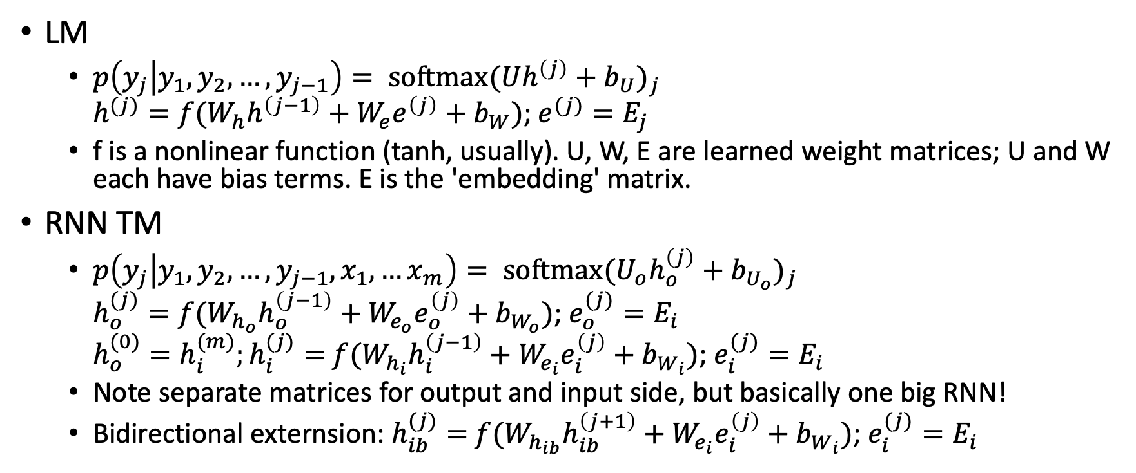
RNN LM vs RNN TM, mathematically
LM
$p\left(y_{j} | y_{1},y_{2},…, y_{j−1}\right)= {\text{softmax}(Uh^{\left(j\right)}+b_{U})}_{j}$ $h^{(j)}=f(W_{h}h^{\left(j−1\right)}+W_{e}e^{\left(j\right)}+b_{W})$; $e^{(j)}=E_{j}$
f is a nonlinear function (tanh, usually). U, W, E are learned weight matrices; U and W each have bias terms. E is the 'embedding' matrix.
RNN TM
$p\left(y_{j} | y_{1},y_{2},…, y_{j−1},x_{1},…x_{m}\right)= {\text{softmax}(U_{o}h_{o}^{\left(j\right)}+b_{U_{o}})}_{j}$ $h_{o}^{(j)}=f(W_{h_{o}}h_{o}^{\left(j−1\right)}+W_{e_{o}}e_{o}^{\left(j\right)}+b_{W_{o}})$; $e_{o}^{(j)}=E_{i}$ $h_{o}^{(0)}=h_{i}^{(m)};h_{i}^{(j)}=$ $f(W_{h_{i}}h_{i}^{\left(j−1\right)}+W_{e_{i}}e_{i}^{\left(j\right)}+b_{W_{i}})$; $e_{i}^{(j)}=E_{i}$
Note separate matrices for output and input side, but basically one big RNN!
Bidirectional externsion: $h_{ib}^{(j)}=$ $f(W_{h_{ib}}h_{ib}^{\left(j+1\right)}+W_{e_{i}}e_{i}^{\left(j\right)}+b_{W_{i}})$; $e_{i}^{(j)}=E_{i}$

Slide 40
(Multi-level generalization)

Slide 46
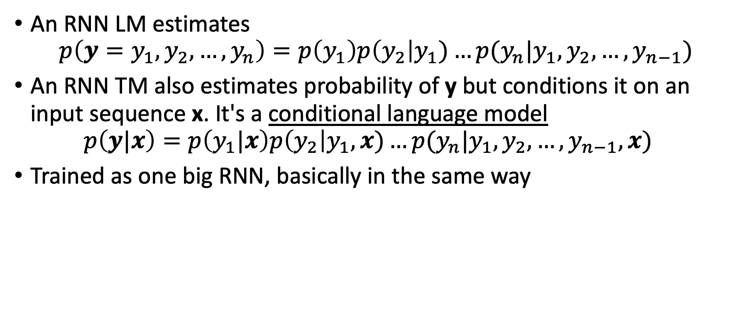
From Language Model to Translation Model
An RNN LM estimates $p\left(y=y_{1},y_{2},…, y_{n}\right)=p\left(y_{1}\right)p\left(y_{2}\right|y_{1})…p(y_{n}|y_{1},y_{2},…, y_{n−1})$
An RNN TM also estimates probability of y but conditions it on an input sequence x. It's a conditional language model $p\left(y|x\right)=p\left(y_{1}|x\right)p\left(y_{2}\right|y_{1},x)…p(y_{n}|y_{1},y_{2},…, y_{n−1},x)$
Trained as one big RNN, basically in the same way

Slide 48
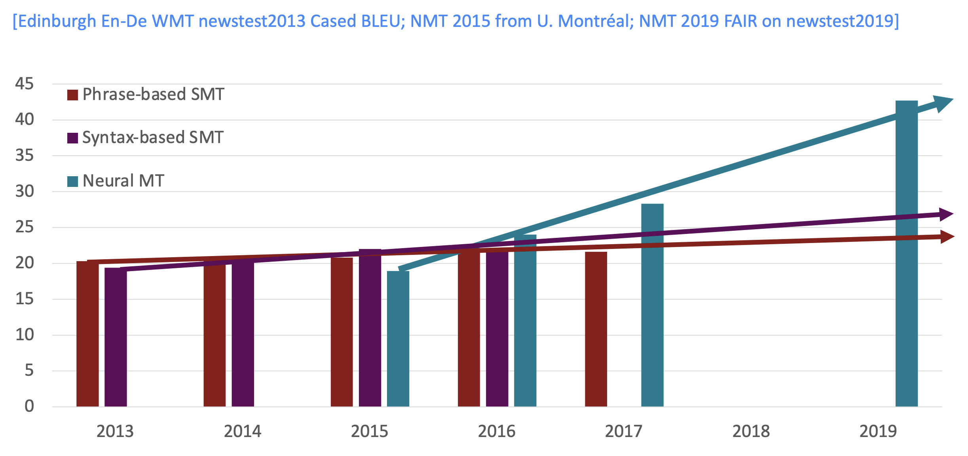
Progress in MT over Time

Slide 50
And this is before transformers!

Slide 51
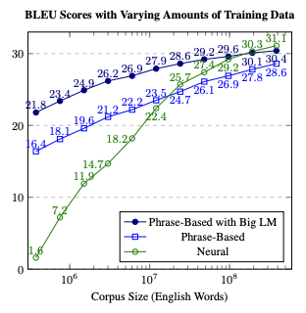
Koehn Knowles 2017
Thamme Gowda thesis defense (2022)

Slide 52
(In 2023, it has kind of waned...)
2022

Slide 67
Note: in practice there are lots of places attention can go in the networks

Slide 68
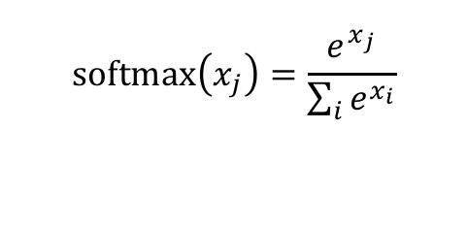
(no parameter variant; see also linear and FF variants)
$$\text{softmax}\left(x_{j}\right)=\frac{e^{x_{j}}}{\sum_{i}{e^{x_{i}}}}$$

Slide 70
Maybe attention is...all we need?
(see handout)

